Slide 1
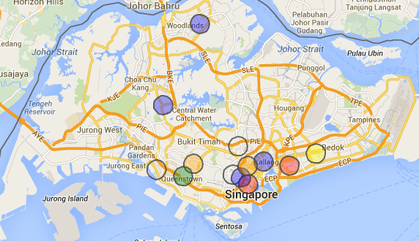
YAHI
Crowd-Sourced Haze-Mapping

Slide 2


Slide 3
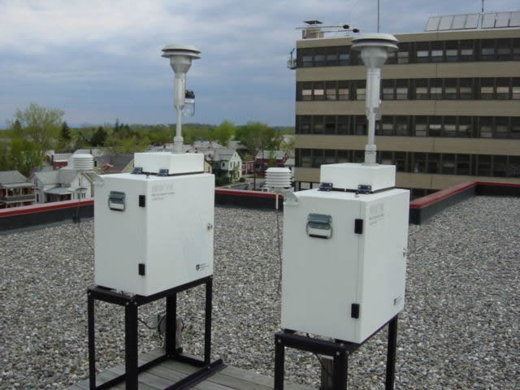
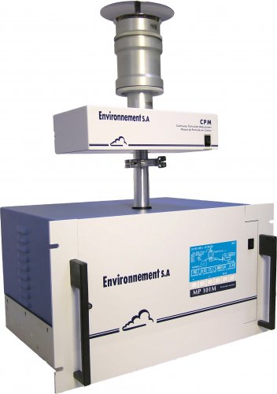
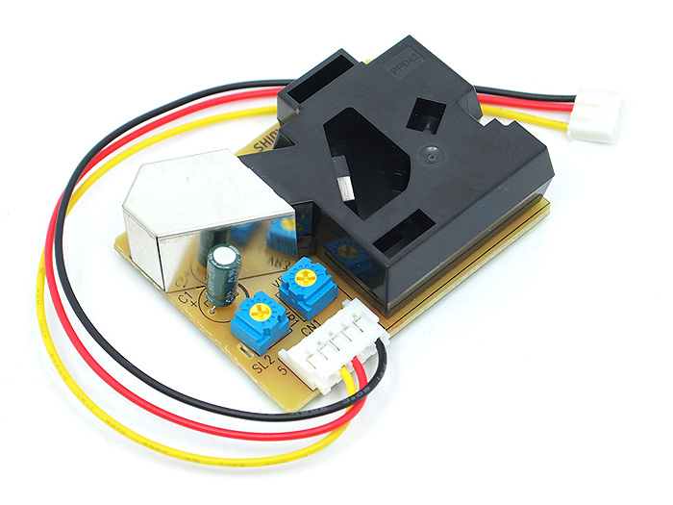

Slide 4
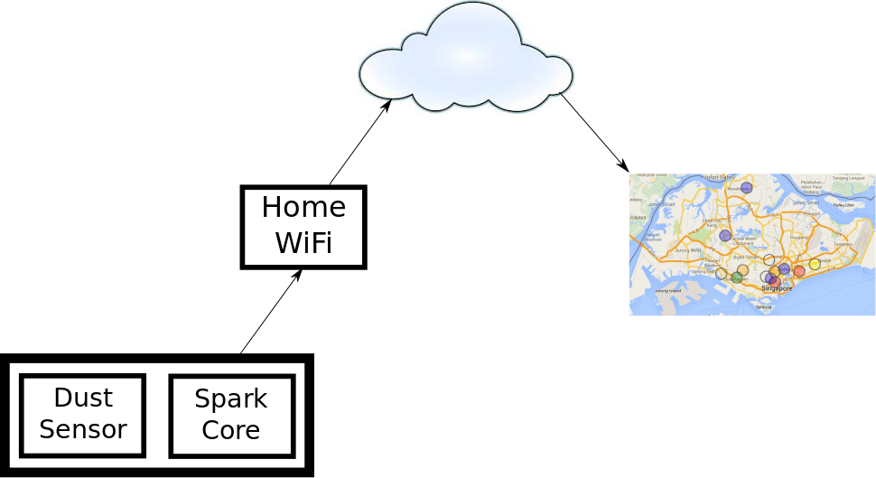

Slide 5
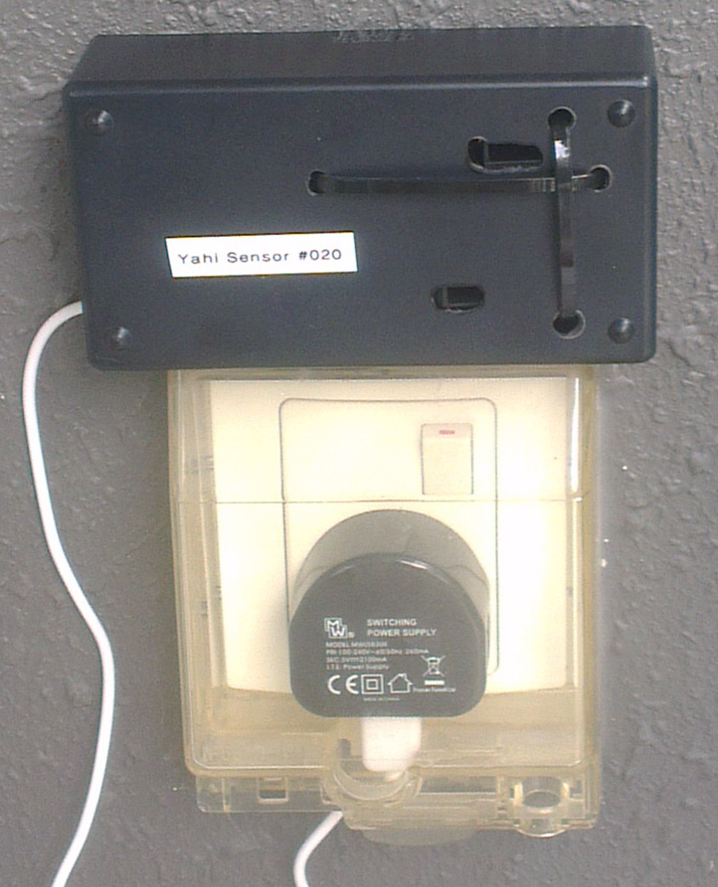

Slide 6
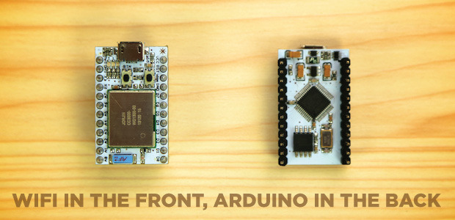

Slide 7
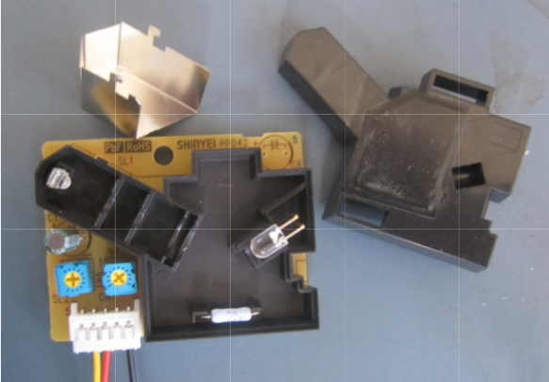

Slide 8
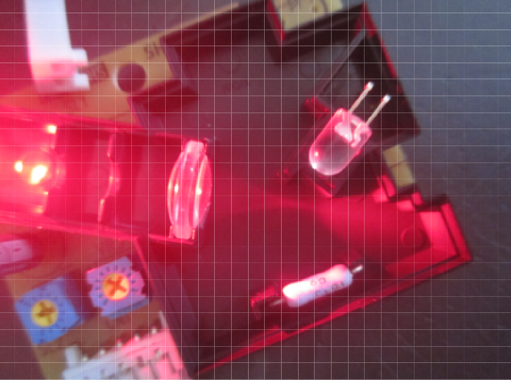

Slide 9
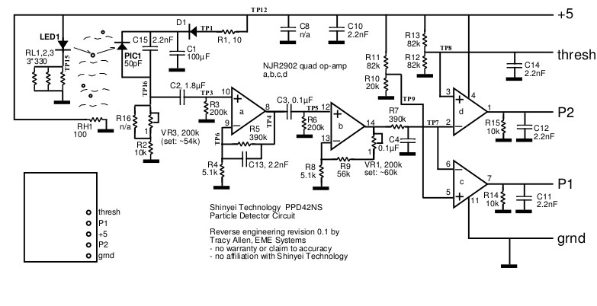

Slide 10
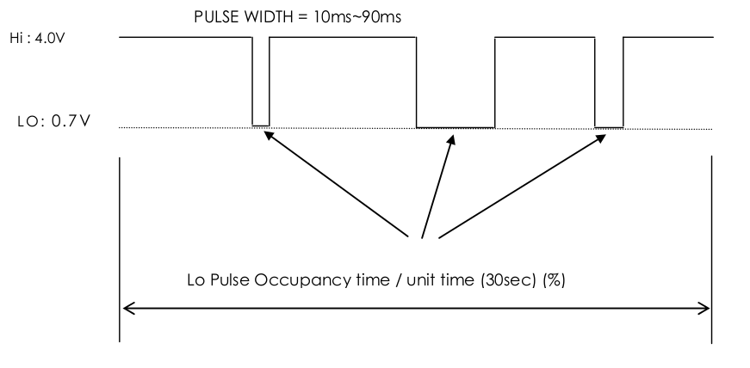

Slide 11
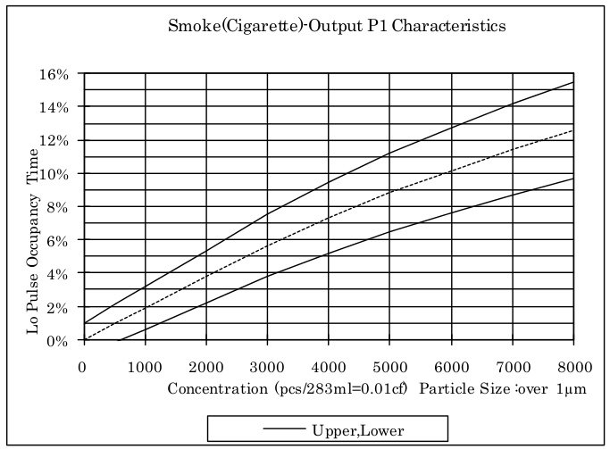

Slide 12
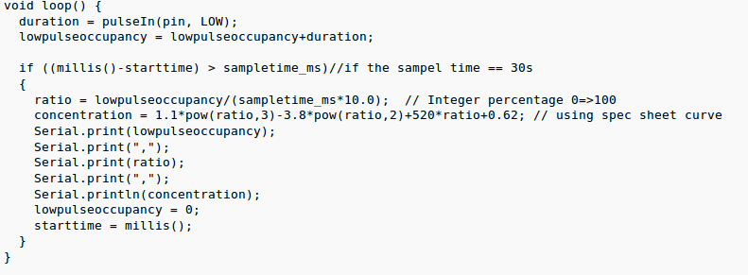

Slide 13
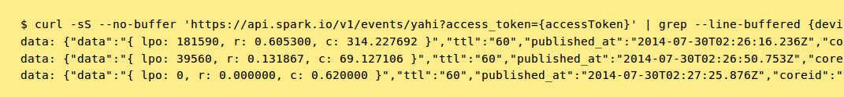

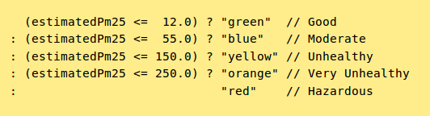
Approximation!
Extrapolation!

Slide 14
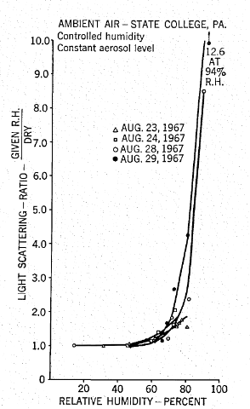

Slide 15
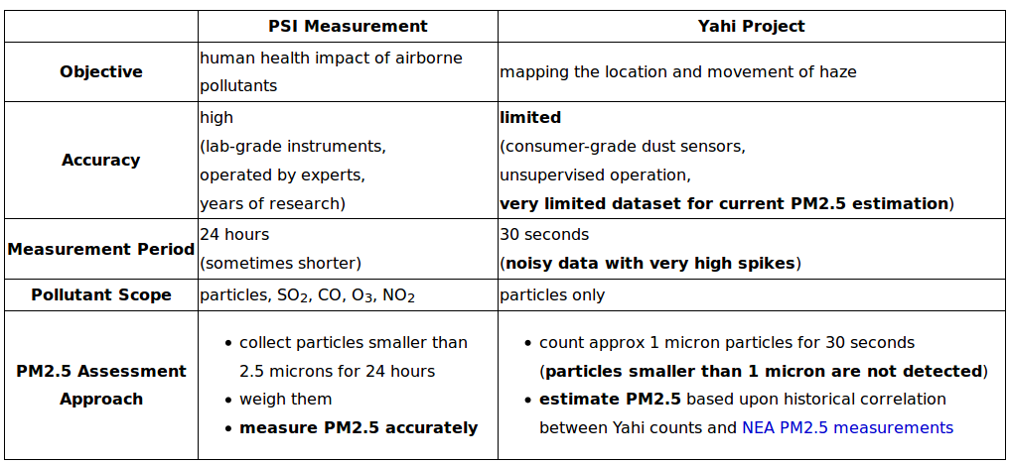

Slide 16
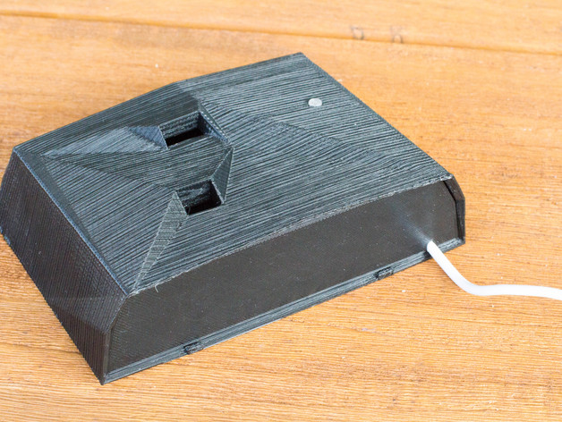
Refinements

Slide 17
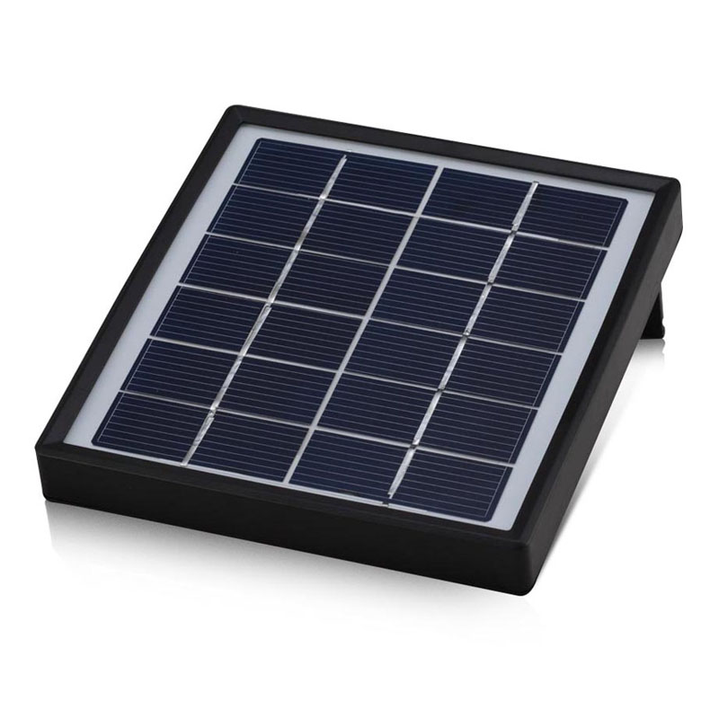
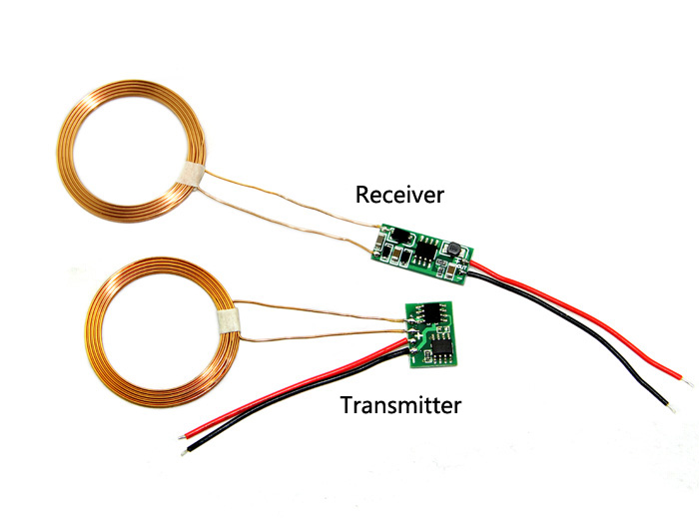
Refinements

Slide 18
Lessons Learned
NEA is reasonably supportive
Immature devices
Finding appropriate volunteers was difficult
Measuring 1𝛍m proxy works

Slide 19
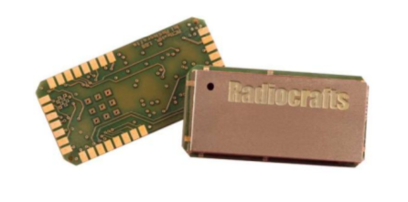
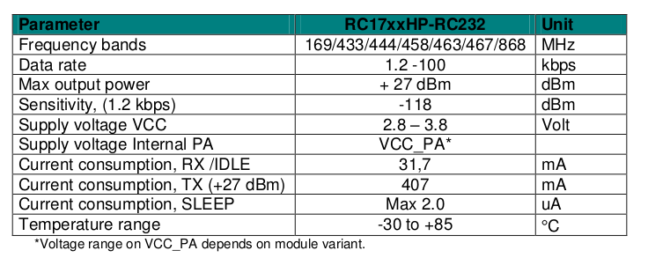

Slide 20
Status, Next Steps, Help
10-12 sensors operating
Aiming for 50-60 this year, good coverage
Archival data, live feed, API
Publish backend source
Add humidity sensors, mesh modules, battery and charger
Data viz
Mobile apps
http://rolandturner.com/yahi

Slide 21



